Slide 1

case study
Developing an Ann model in python
FINANC IAL MACHINE LEARNING
Subject code:
Academic year [ 2024-25 ODD]
Faculty in-charge : Dr K.Shantha Kumari (Associate Professor, Data Science and Business Systems, School of Computing, SRMIST, KTR)
Presenter :GADDE VAMSHI,RA2112704010017, GitHub.

Slide 2

Introduction
Artificial Neural Networks, or ANNs, are one of the most powerful and widely used methods in machine learning and artificial intelligence today. Modeled loosely after the human brain, ANNs are designed to recognize patterns in data and can be applied to a vast range of applications, from image recognition and natural language processing to financial forecasting and disease diagnosis.
In recent years, developing neural networks has become much more accessible, thanks in part to high-level libraries like Keras. Built on top of popular machine learning frameworks like TensorFlow, Keras allows developers to create, train, and fine-tune neural networks efficiently. It simplifies the complex mathematics behind deep learning, making it easier to build high-quality models with just a few lines of code.

Slide 3
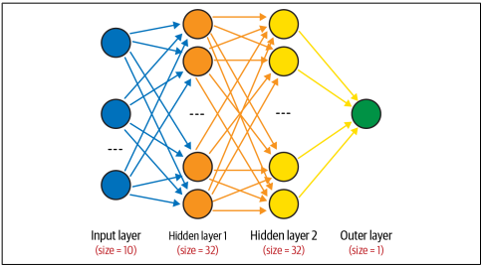
Problem Definition
The primary objective of this project is to build a simple Artificial Neural Network (ANN) model for binary classification using Keras. Binary classification is a common machine learning task where we categorize data points into one of two possible classes.
To achieve this, we need a dataset with multiple input features and a target variable that has two possible outcomes, such as "yes" or "no," or "0" and "1." The ANN will be trained to recognize patterns in the input data that can predict the correct class.

Slide 4




Challenges and Considerations
Building an effective Artificial Neural Network (ANN) involves several challenges and considerations. First, data quality and quantity are critical, as poor data can hinder the model's learning ability, while more data generally improves performance. Avoiding overfitting is another key concern; techniques like dropout and early stopping help the model generalize better to new data. Additionally, choosing the right architecture, including layers and hyperparameters, often requires experimentation. Since ANNs can be computationally intensive, especially with larger datasets, using GPUs or cloud resources can significantly speed up training. Finally, evaluating the model with metrics beyond accuracy, such as precision and recall, ensures a deeper understanding of performance, particularly when handling imbalanced data.
Performance Trade-offs
Model Maintenance
Data Privacy
Real-time Processing
Balancing false positives and false negatives for optimal system performance.
Regular retraining and updating to adapt to evolving fraud patterns.
Ensuring compliance with data protection regulations and maintaining customer trust.
Implementing the model for fast, real-time transaction screening.

Slide 5
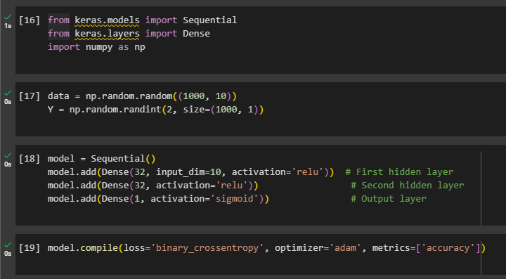
Code Implementation Steps

Slide 6
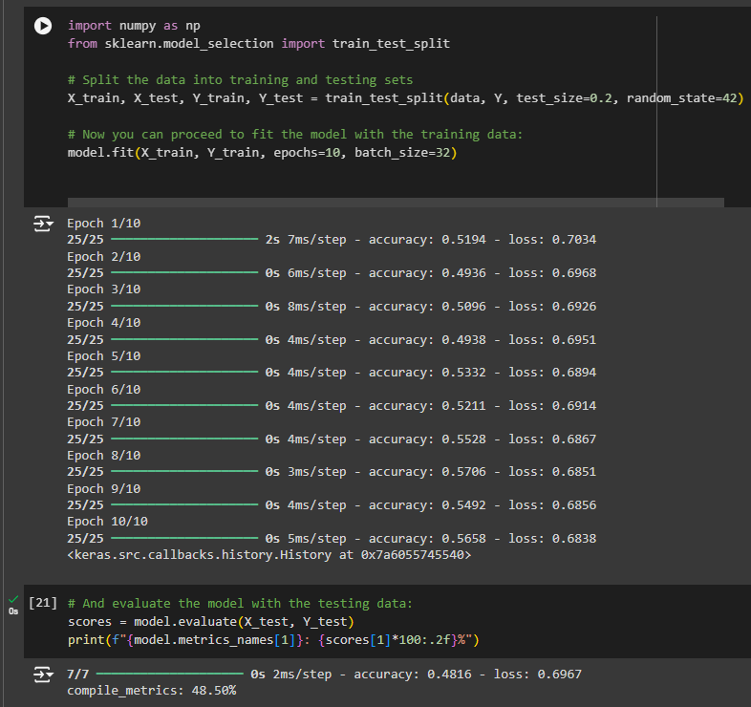
Code Implementation Steps

